Slide 1
RESTAURANT ANALYSIS
ZOMATO
PRESENTING BY: SUNNY MEHTA
DATE- 13/08/2025

Slide 2
CONTENTS
Problem Statement
Data Overview & Data Cleaning
Suggested Countries
Cities in Suggested Countries
Count number of restaurants in each country.
Annual Restaurants Opening count Overview
Average Voting in the suggested Countries
Total Expenditure on Foods
Choice of most rated top Cuisines
Mode of Table Bookings
Mode Of Delivery Bookings
Price Range Wise Restaurants
Average Of The Ratings Per Country
Dashboard

Slide 3
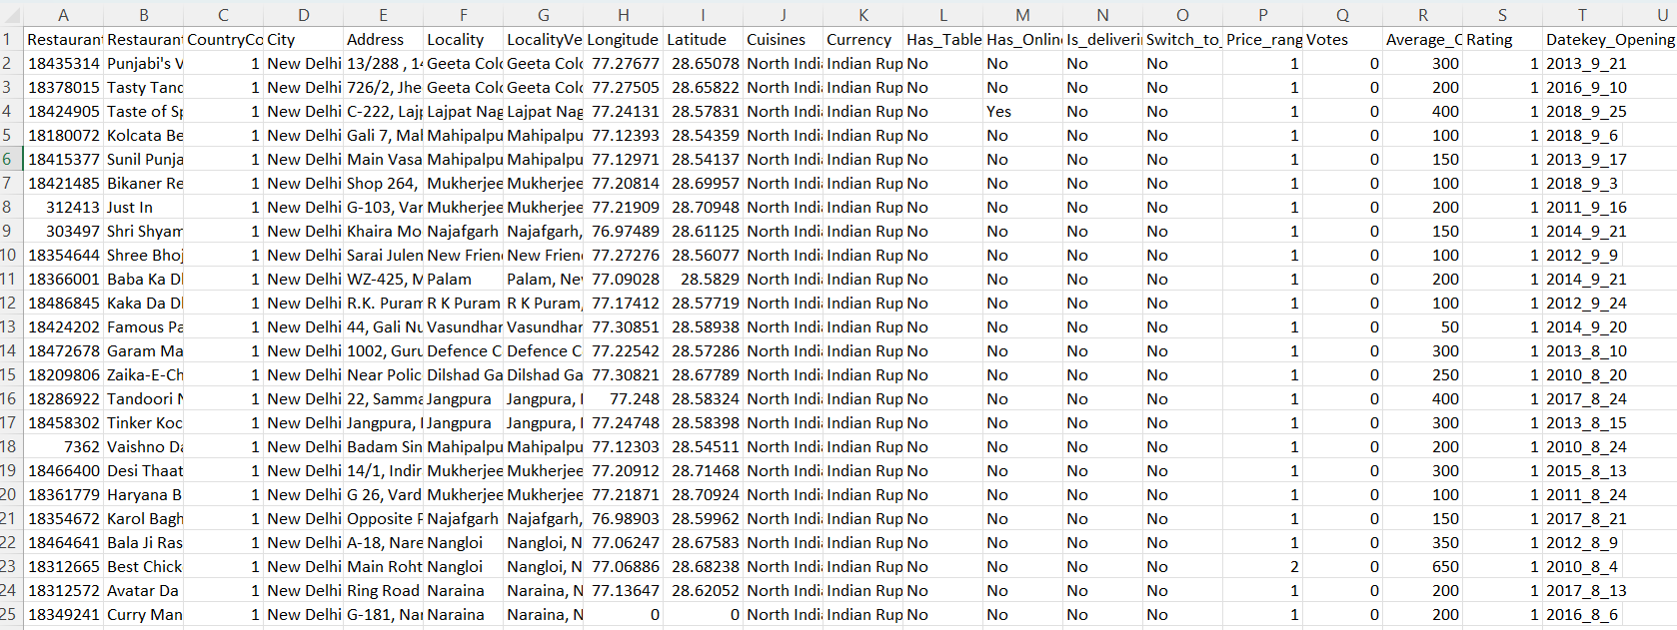
PROBLEM STATEMENT
You are hired as a consultant data analyst by Zomato where the team is looking for expansion and opening restaurants. Your task is to come up with strategies/suggestions for opening newer restaurants.

Slide 4
DATA OVERVIEW & DATA CLEANING
Data Overview
There is a total of 9551 restaurants worldwide.
Most of the restaurants were opened in the year 2018.
We can see that most restaurants have online deliveries and table bookings.
Restaurants have a price range between 1- 4.
Different restaurants have different ratings based on their cities’ cuisines and price range.
Data Cleaning
There are 9 blank cells found in the column cuisines are replaced by cuisines based on their country codes.
All currencies are updated in the Indian Rupees in the new column created named currency Updated.
Create a new column date-key to define date formate.
Extract year from column date-key column
Extract month name from column date-key
Data is well maintained with the help of wrap text, borders and Bold functions.

Slide 5




SUGGESTED COUNTRIES
Australia
Canada
Sri Lanka
Singapore

Slide 6
CITIES IN SUGGESTED COUNTRIES
Australia
Singapore
Armidale
Balingup
Macedon
Penola
Flaxton
The cities with the lowest ratings are the most suitable for the opening of new restaurants.
Singapore
Canada
Sri Lanka
Consort
Yorkton
Colombo

Slide 7

Count number of restaurants in each country.
Generally I have count the number of restaurants open in each country
This process is use to identify how many restaurants in par country
I have created a pivot table for identify the restaurants
Then for visualization I insert a 3D column chart
The Data shows the Number restaurants in India is more than
The other counties.

Slide 8
Annual Restaurants Opening count Overview
First I create new column name - Year
Then I created a pivot table for analyze how many restaurant are open per year
For visualization I create a 3D bar chart for visualize the data

Slide 9
ANNUAL RESTAURANTS OPENING OVERVIEW
The Data Shows Stable Growth In The Restaurant Industry, With Occasional Fluctuations Due To Economic Factors
Analyzing The Data, We Can Observe The Trends In Restaurants Opening Across Different Years.
2010: Increased to 1,080 new openings, showing growth.
2011: Rose to 1,098 openings, continuing upward trend.
2012: Slight dip to 1,022 due to possible market saturation
or economic factors.
2013: Rebounded to 1,061 openings, indicating renewed growth.
2014: Minor decline to 1,051, maintaining steady progress.
2015: Stable at 1,024 new openings, reflecting consistent demand.
2016: Slightly up to 1,027, showing industry resilience.
2017: Increased to 1,086, driven by renewed consumer interest.
2018: Peaked at 1,102 openings, the highest in the period, signalling strong market growth.

Slide 10
AVERAGE VOTING IN THE SUGGESTED COUNTRIES
Based On The Provided Voting Data,
Sri Lanka: Highest average voting score of 146, reflecting strong voter engagement.
Australia: Average score of 111, indicating moderate interest.
Canada: Score of 103, showing slightly lower engagement.
Singapore: Lowest average score of 32, suggesting reduced voter participation.
Overall, the Data Suggests Varied Levels Of Voter Engagement Across These Countries.

Slide 11
Total Expenditure on Foods
Based On The Provided Data,
Turkey: It is a Lowest Food Expenditure Value
Singapore: It is highest Food Expenditure Value.
Qatar : It Is Medium Food Expenditure

Slide 12

Choice of most rated top Cuisines
According to my analysis, most individuals prefer their local cuisine over foreign cuisines, and restaurants that serve local cuisine and have higher ratings tend to receive better feedback. Thus, I've chosen a few regional dishes as well as a few more that received better reviews.
Here are the top ten cuisines in the suggested countries based on customer feedback.

Slide 13

MODE OF TABLE BOOKINGS
Research shows no restaurants in these countries currently offer table booking services, presenting an opportunity for innovation.
74.34% of restaurants cater to walk-ins; 25.66% offer table bookings, likely for formal dining or high-demand areas.
The data shows If The Table Booking Is Yes rating is also high Almost 3.5 and Table Booking No Rating is Almost 3 its generally Low.
so, we Have To Offered Table Booking For Better feedback
87.88% of restaurants serve walk-ins without online delivery; 12.12% provide it, likely in high-demand or formal dining locations.
Table Booking

Slide 14

MODE OF ONLINE BOOKINGS
If we have see the data Restaurant provide online delivery Then rating is generally high almost 3.3 and restaurant don’t offerd online delivery rating is generally low
So, restaurants need to provide online delivery for getting higher feedback and better response .
87.88% of restaurants serve walk-ins without online delivery; 12.12% provide it, likely in high-demand or formal dining locations.

Slide 15
Price Range Wise Restaurants
The Data show High number of restaurants price range 1.
India have 4295 restaurants price range 1.
India have 2858 restaurants price range 2.
India have 1111 restaurants price range 3.
India have 388 restaurants price range 4.
Most of the restaurants price range 1 are India .

Slide 16
Average Of Rating Per Country
For Analyze the rating per country
I create a pivot table for summarizing the Average rating per country
Also, I Create a pivot chart, chart name 3D Bar chart
When we look at the chart the data show average rating per country.

Slide 17
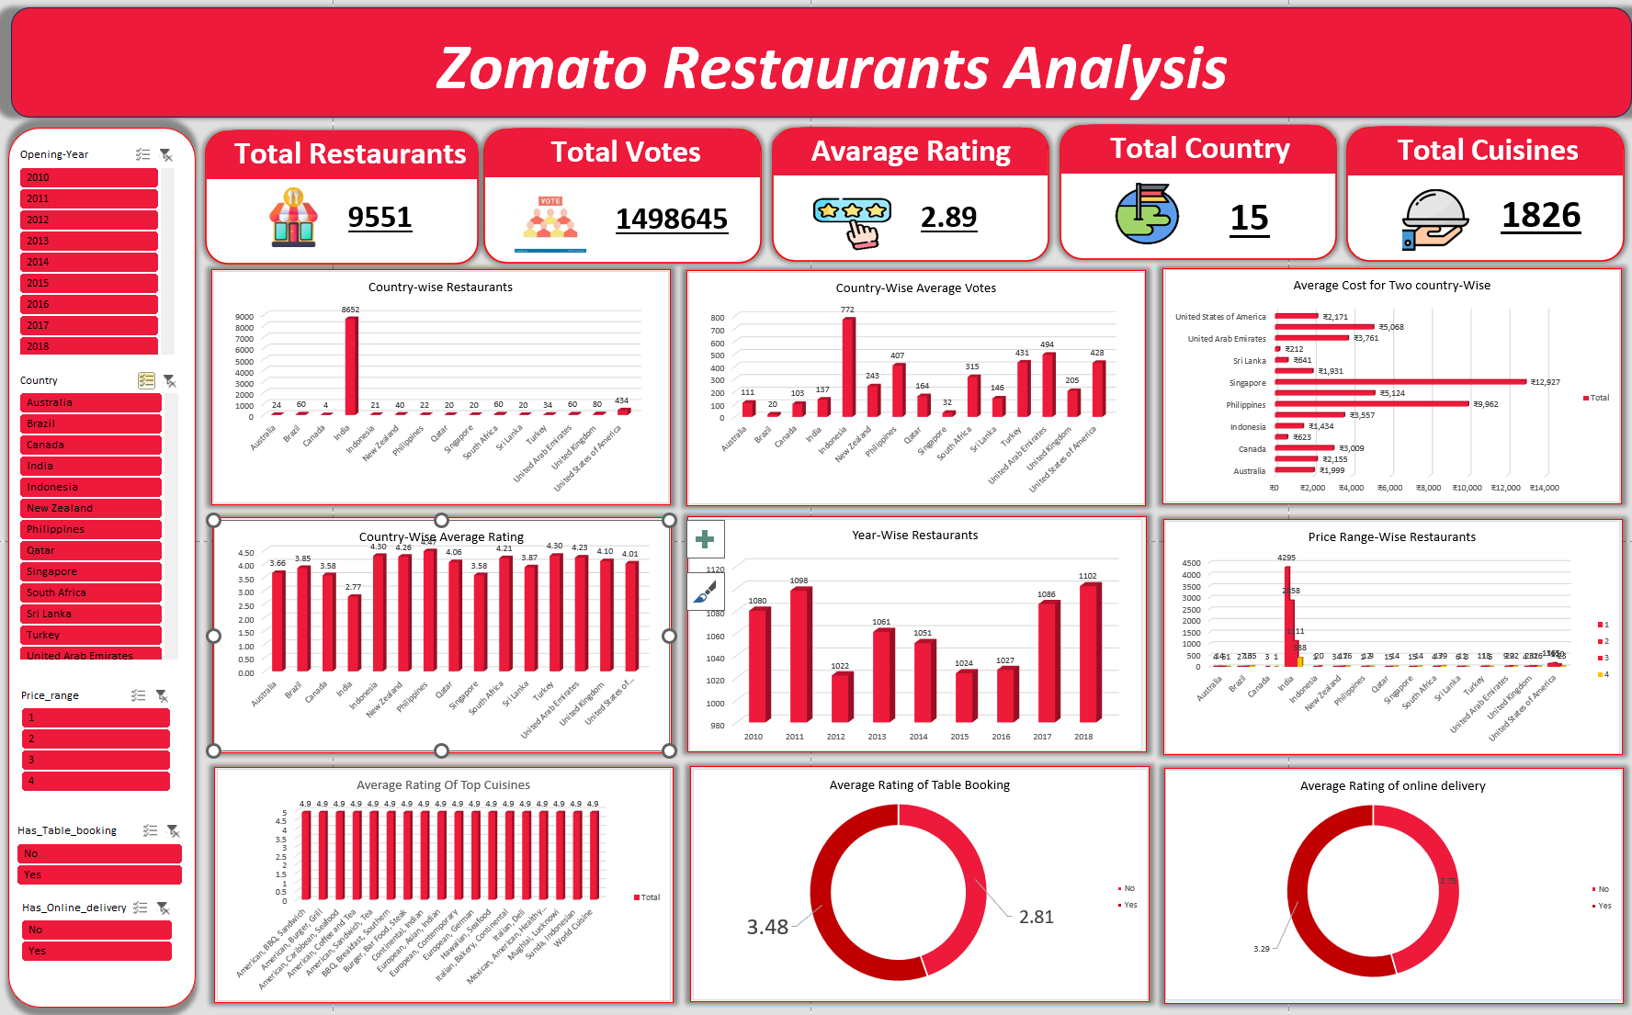
DASHBOARD
DASHBOARD

Slide 18
Conclusion And Recommendation.
This dashboard provides a comprehensive overview of Zomato restaurant analytics, capturing key metrics across various dimensions. Here’s a breakdown of the dashboard elements:
Total Restaurants, Countries, Cities, Cuisines: Displays a high-level summary of the Zomato dataset, showing the total number of restaurants (9,551), countries (15), cities (141), and cuisines (1,826) represented in the data. This gives a quick snapshot of the scale of operations.
Total Votes and Average Rating: Summarizes user engagement through total votes (14,98,645) and provides an overall average rating (2.89). These metrics indicate customer interaction and satisfaction levels.
Year-wise Restaurants: A 3D column chart shows the number of restaurants added each Year. The trend helps in understanding the growth over time and identifying peak periods.
Country-wise Restaurants: A 3D column chart represents restaurants’ distribution across different countries, with the United Kingdom leading with 80 restaurants. This can inform market penetration and regional focus.
Table Booking and Online Delivery: Donut charts provide insights into customer behaviour. High percentages for online delivery (93.98%) and table booking (89.89%) highlight the importance of these services.
Rating vs. Restaurants: A bar chart mapping the number of restaurants against their ratings. This helps in identifying how many restaurants fall within specific rating brackets, useful for quality assessment.

Slide 19
Conclusion And Recommendation.
Popular Cuisines: A bar chart showcasing the popularity of different cuisines, with Turkey and Brazil being particularly notable. This insight can guide menu decisions and marketing strategies.
Interactivity
Filters and Slicers: The dashboard includes ﬁlters for selecting speciﬁc cities, years or rating ranges, making it easier to drill down into the data for more detailed analysis.
Example: Users can ﬁlter the dashboard to view only high-rated restaurants in a particular city, helping to focus on top-performing areas for strategic decision-making.

Slide 20
Thank You!

